Slide 1

Computational Physics
Lesson 1 - Introduction

Slide 2
Learning Objectives
Appreciate the importance of computational methods.
Write simple programs to implement computational methods.
Use existing tools to do computations and extract meaningful results.

Slide 3
Course Plan
Introduction
Differential Equations and Time Stepping (DIY)
Further Differential Equations, using solvers
Introduction to monte carlo methods
Applications of monte carlo methods
Applications of monte carlo methods

Slide 4
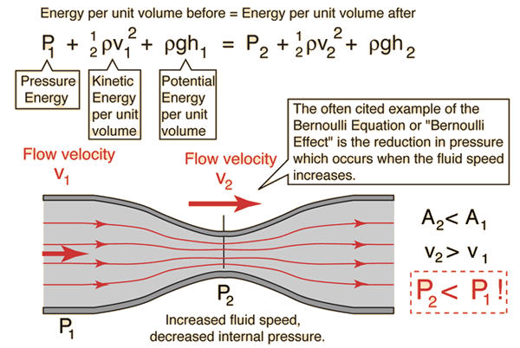
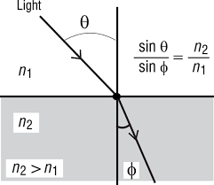
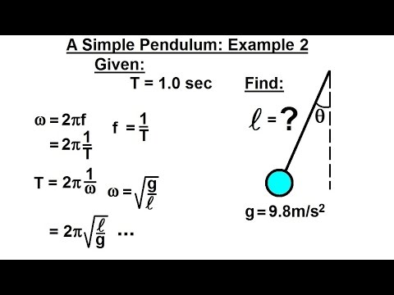
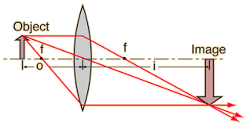
Introduction – Physics in High School
Simple equations, strong assumptions, problems that can be solved using just a calculator

Slide 5
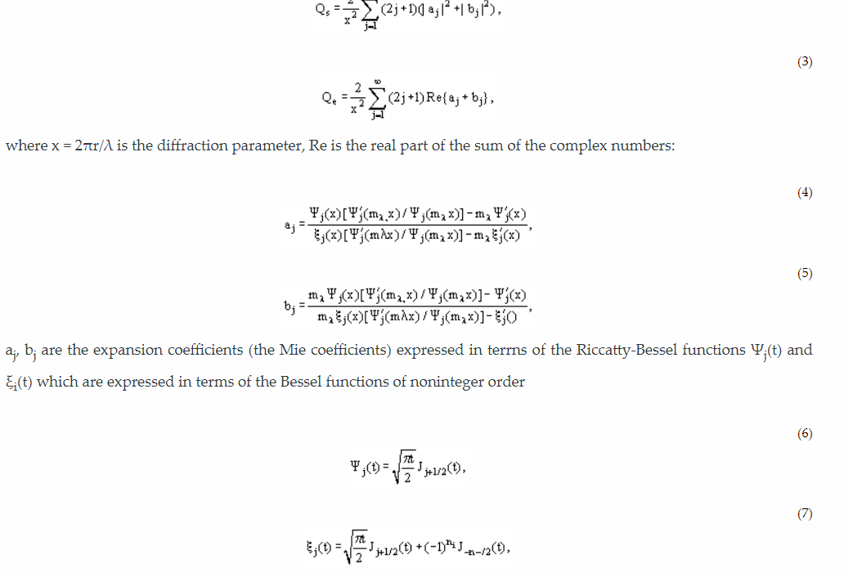
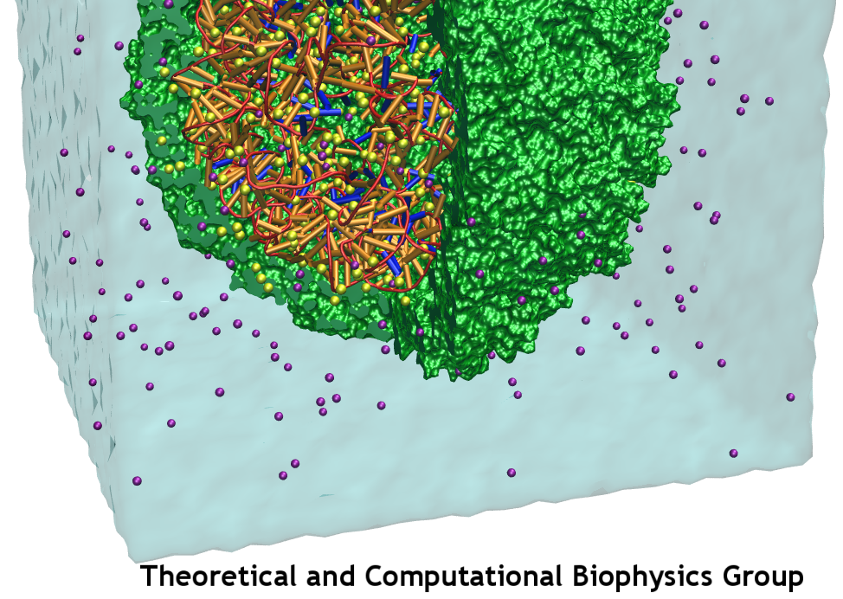
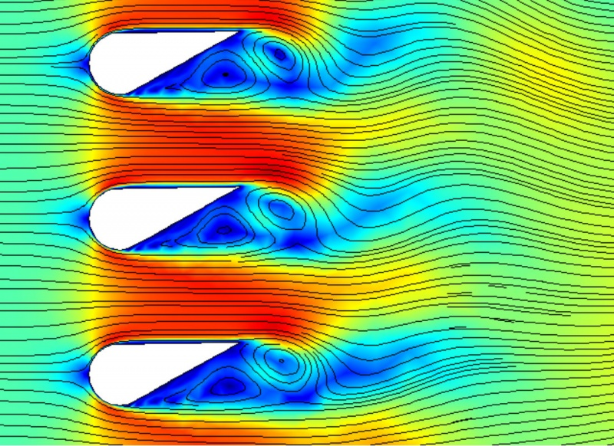

Real-World Problems
Simple assumptions may not be satisfied.
Even if the underlying equations are simple, the system may be large or complex.
Relatively simple equations may not have a solution that can be written down (in terms of standard functions)

Slide 6
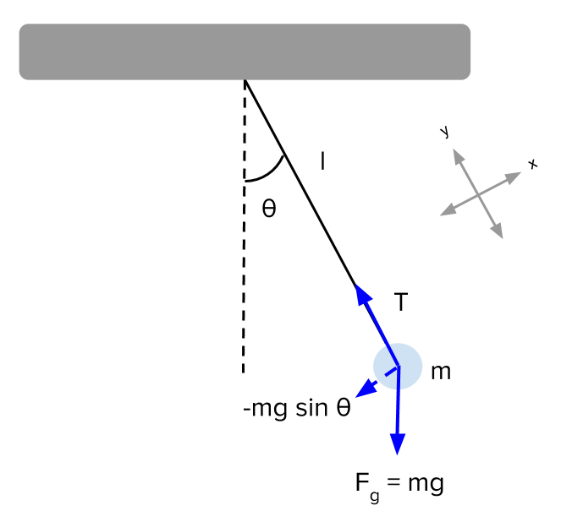
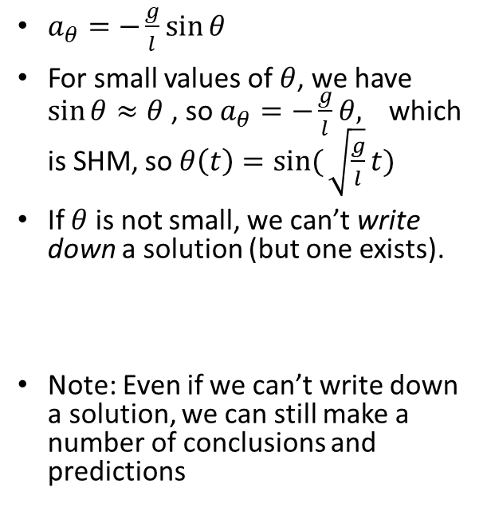
Example – Simple Pendulum
$a_{θ}=−\frac{g}{l}\sin{θ}$
For small values of $θ$, we have $\sin{θ≈θ}$, so $a_{θ}=−\frac{g}{l}θ,$ which is SHM, so $θ\left(t\right)=sin({\sqrt{\frac{g}{l}}}t)$
If $θ$ is not small, we can’t write down a solution (but one exists).
Note: Even if we can’t write down a solution, we can still make a number of conclusions and predictions

Slide 7
Double Pendulum
This has very complex (in fact, chaotic) behaviour

Slide 8
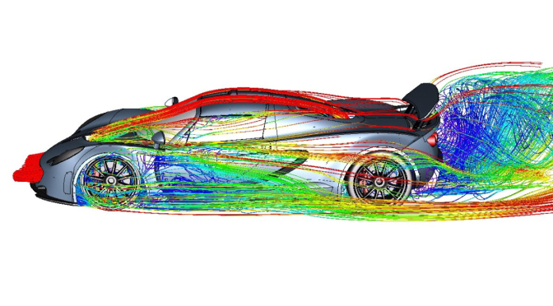
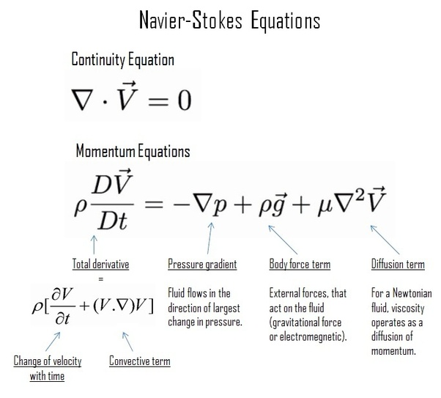
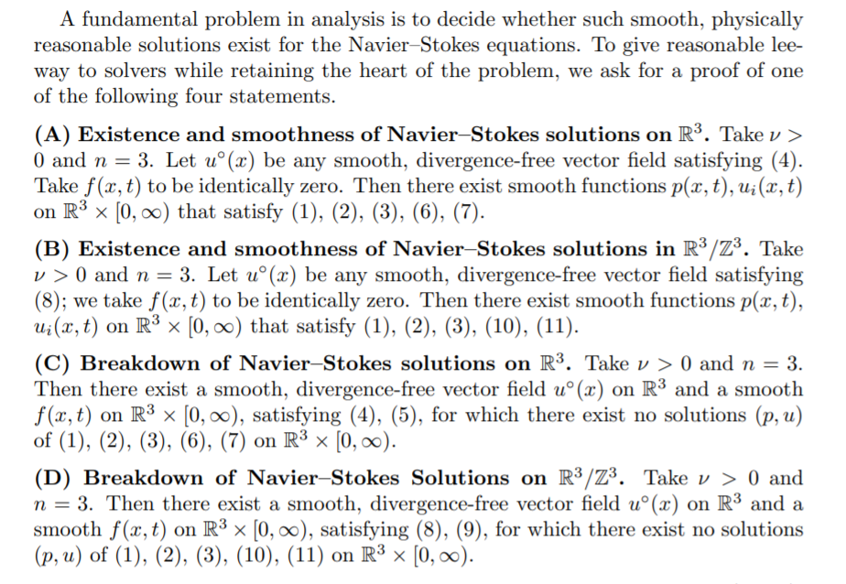
Example 2 – Naiver-Stokes Equation
You get a million dollars if you can prove that a solution exists.

Slide 9
Mentality/Expectations of this Course
Lessons serve as an introduction to the material. You will learn by working on the assignments.
Lessons don’t give enough information to complete the assignments. You may need to ask for help, search for programming tutorials or do some research.
Be intellectually curious. If you want to extend the assignment (by doing more work), then do so, or ask for trickier tasks.

